Slide 1

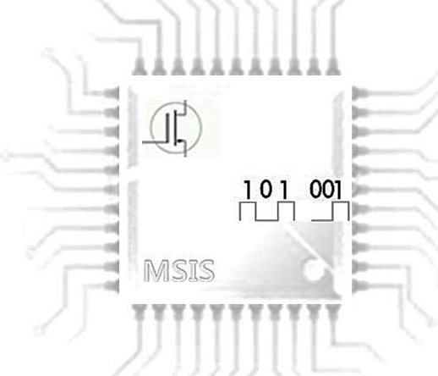

On-Chip Voltage Scaler Circuits with Energy-Efficient Charging and Recycling
Prof. HyungWon Kim
Dept. of Electronic Engineering,
College of Electrical Engineering and Computer Science,
Chungbuk National University
MSIS

Slide 2
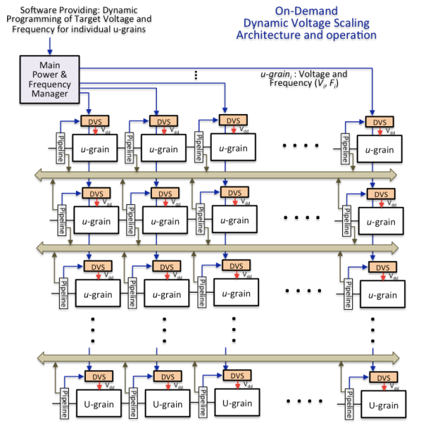
Research Goal of Low Power Voltage Scaler
On-Chip Dynamic Voltage Scaler for Multiple Power Domain
Dynamic Power Management For Multiple micro-grain power domains
Wide input and output voltage range
On-Demand Dynamic output voltage scaling
Small form factor On-chip Switched Capacitor Voltage converter and Scaler

Slide 3
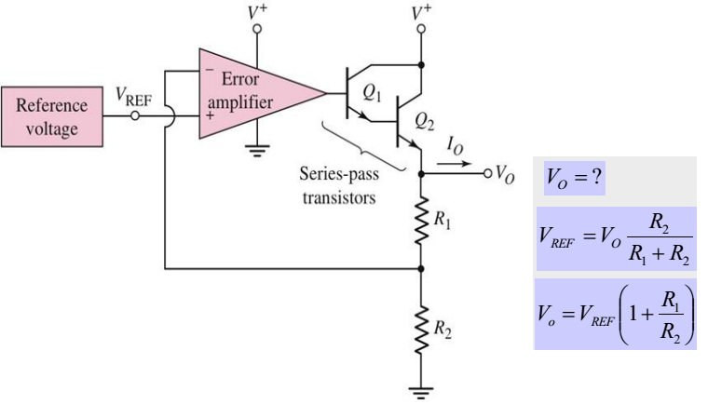
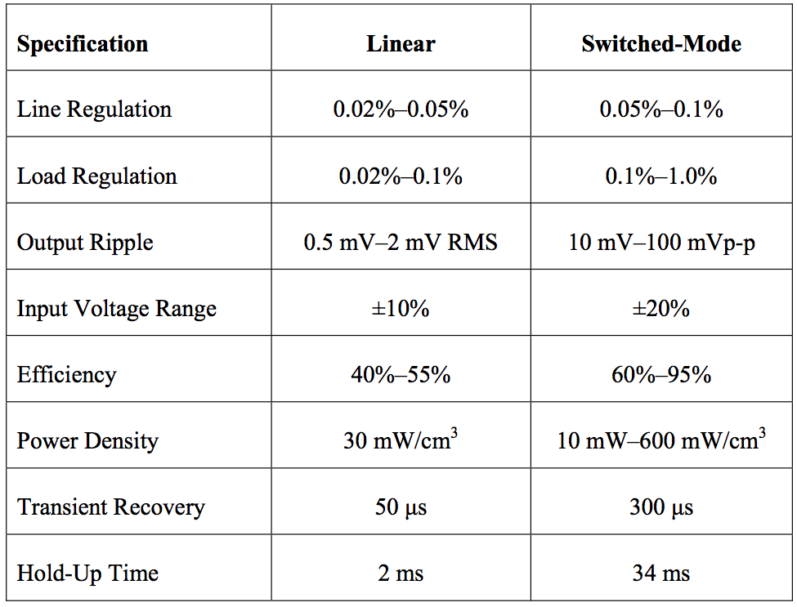
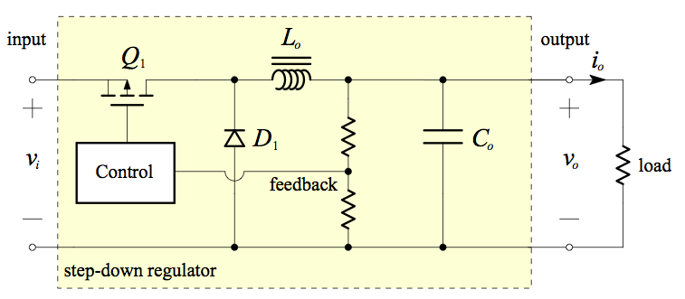
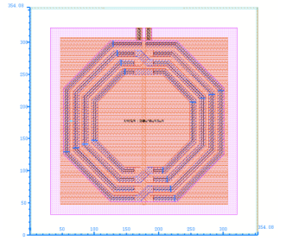
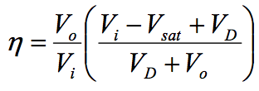
Conventional Voltage Converters
Linear Voltage Regulator: LDO (Low Drop Out)
Inductor Based DC-DC Converters (Buck Converter)
Layout of 5.5 nH inductor with area of (354.08 µm)²

Slide 4
Switched Capacitor (SC) DC-DC Converters
Requirements for On-Chip DC-DC Converters and Regulators
Multicore processors dissipate power in the range of 1 W/mm²
Integrated dc–dc conversion requirements:
Steps down from a conveniently chosen voltage above typical CMOS core operating voltages;
Provides high efficiency over a wide load and voltage range;
Highly scalable for granular implementation
Problems of Inductor DC-DC Converters
High-power requires intensive integrated inductor or a bulky off-chip inductor
Transistors rated for the full input voltage and the full output current of the application
Advantage of SC Converters
Requires only capacitors as passives
Capacitors have significantly higher energy and power densities
More easily integrated than inductors
Drawback of SC Converters
Limited to low-power (<100 mW) applications
High ripple voltages & relatively large output voltage granularity
On-chip capacitors still requires large chip area
Additional Benefits of SC Converters
NMOS Switches need about 1 V rating (whereas buck converters need 10 V rating)
No inductive switching losses, and less overshoots, body diode conduction, and less timing issues
Low-power operation without control complexity, reducing clock rate.
Higher Energy density of capacitors, orders of magnitude greater than inductors.

Slide 5
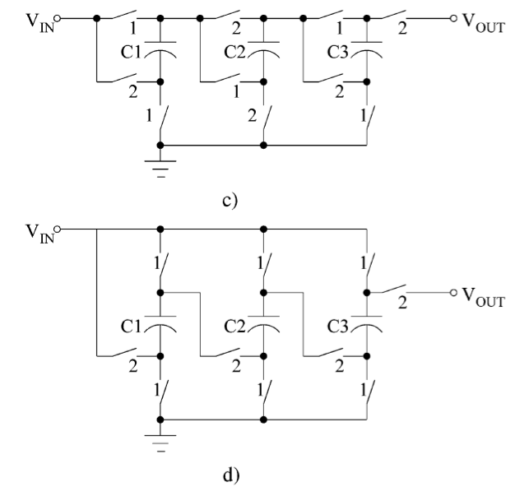
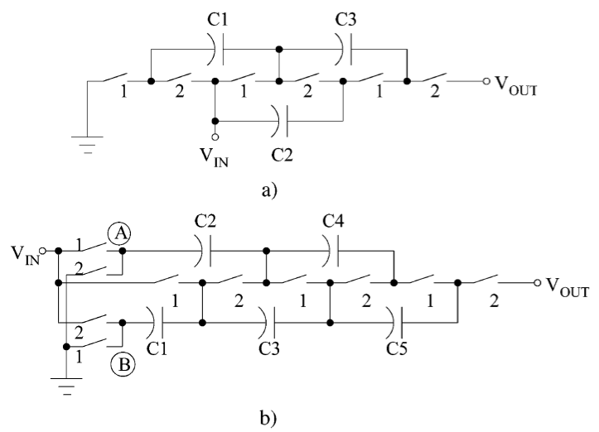
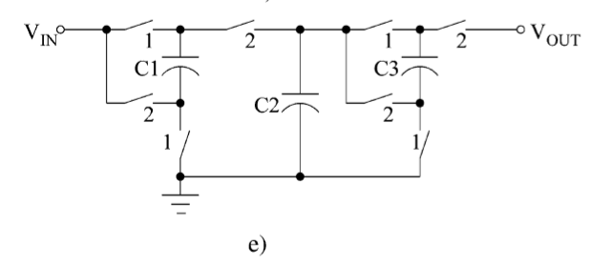
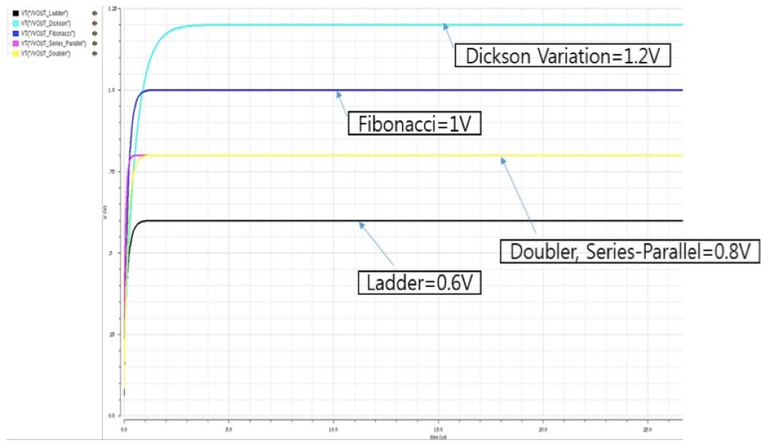
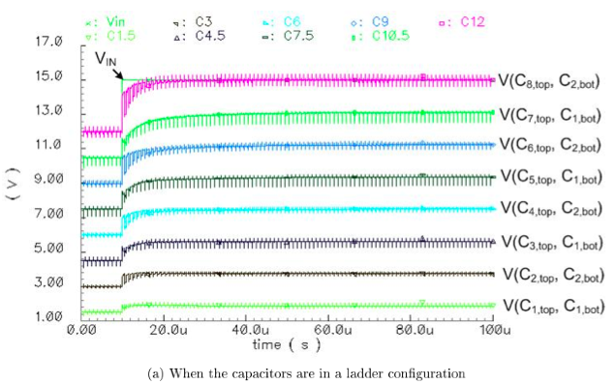
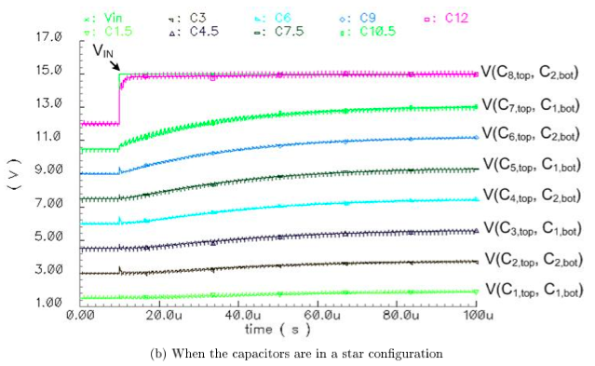
Switched Capacitor (SC) DC-DC Converters
Switched Capacitor Voltage Converter Types
Five Step-Up Converters Compared
(a) Ladder
(b) Cockcroft-Walton Multiplier (Dickson Variation)
(c) Fibonacci
(d) Series-Parallel (or Parallel Series)
(e) Doubler
Ladder (Variation) Converter
Dickson Star Converter

Slide 6
Target Architecture of Dynamic Voltage Scaler
Target Dynamic Voltage Scaler Structure
Main Blocks and Path of DVS
Voltage Converter and Storage Analog Block
1st Stage
Reconfigurable Voltage Buck-Boosting Energy Storage
Reconfigurable Coarse level Voltage Output
2nd stage
ULP Switched-Capacitor Voltage Regulator block
Minimize Voltage ripple to further reduce energy waste
DVS feedback controller block
Output voltage feedback circuit
DVS output voltage의 measurement
Ultra Low Powr comparator Circuit
Compare with the target Reference voltage
Dynamic feedback controller
With Comparator’s result, control the Energy storage and Voltage regulator
Low power PLL (Phase Locked Loop) clock generator
Provide control clocks to Energy storage and Voltage regulator
Low Energy Loss Dynamic Voltage Scale Controller Architecture
Voltage Converter and Storage Analog Block
Input
Voltage Source
Reconfigurable Voltage Boosting
Energy Storage
ULP Switched-Capacitor Voltage Regulator
DVS Output
Output
Voltage
Feedback
Circuit
Low Power
Clock Generator
(PLL)
Dynamic
Voltage
Feedback
Controller
ULP Subthreshold
Comparator
V_{ctrl}
DVS Feedback Controller Block
V_{ref}
Voltage Level Selection from Main Power Management

Slide 7
An Energy Efficient Charging Technique for Switched Capacitor Voltage Converters with Low Duty-Ratio
Saad Arslan, Syed Asmat Ali Shah, HyungWon Kim
Dept. of Electronic Engineering,
College of Electrical Engineering and Computer Science,
Chungbuk National University
MSIS

Slide 8
Target Applications: Low Duty Ratio Operation
A circuit is active for a small period of time
Followed by a long sleep period
Problems of dynamic power
Suffer with poor energy efficiency
Due to losses in transition periods
During sleep-to-active transition
DC-DC converter’s capacitor bank is charged
From zero to a certain voltage
In Switched-Capacitor (SC) DC-DC converter
The initial charging is done at 50% energy efficiency
Half the energy from the source is wasted and only half is stored in capacitors

Slide 9
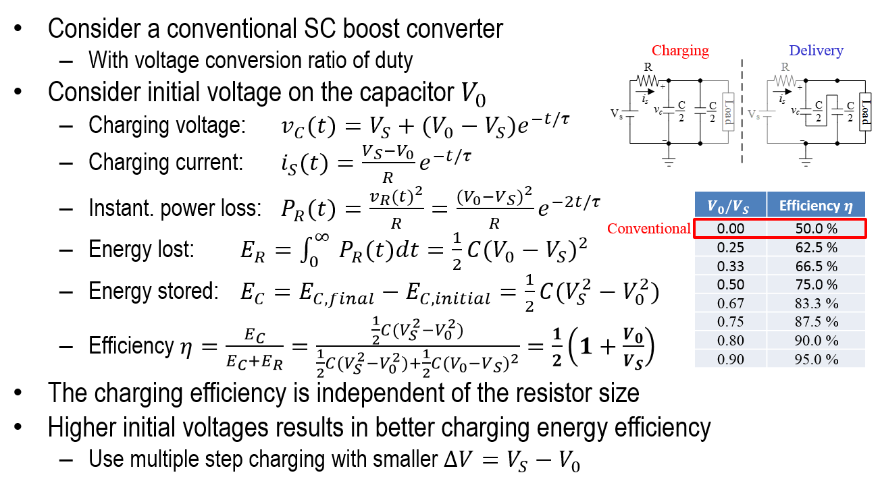
Initial Charging of an SC DC-DC Converter (1/2) -Conventional Converter (One-Step Charging)

Slide 10
Initial Charging of an SC DC-DC Converter (2/2) -Two Step Charging
Using additional charging stage
Efficiency of step 1 & 2 is
𝜂₁= 50% and 𝜂₂=75%
Total charging efficiency 𝜂=66.67%
By adding more charging steps, efficiency can be further improved
Simulation results by using mathematical model in MATLAB
Conventional (one-step charging)
Two-step charging

Slide 11
Initial Charging of an SC DC-DC Converter -Split-Capacitor Charging (Four-Step Charging)
Splitting each capacitor into smaller units, allow more charging steps
By splitting each into three
Four-step charging is obtained
With charging efficiency of 75%
66.67% reduction in energy wastage
Proposed six capacitor bank
Architecture
Configurations during each charging step
Six capacitor, four-step split-capacitor charging simulation.

Slide 12
Initial Charging of an SC DC-DC Converter -Comparison of N-Step Charging
The table shows summary of MATLAB simulation results
For various number of charging steps (including split-capacitor charging),
Showing total efficiency, efficiency of each step and capacitor configuration
 | Total | Charging Steps
 |  | 1 | 2 | 3 | 4 | 5 | 6 | 7 | 8
Capacitors | 1 | 1,1
Efficiency | 49.9% | 49.9%
Capacitors | 2 | 1,2 | 2,1
Efficiency | 66.6% | 49.9% | 75.0%
Capacitors | 4 | 1,4 | 2,2 | 4,1
Efficiency | 72.7% | 49.7% | 75.0% | 75.0%
Capacitors | 6 | 1,6 | 2,3 | 3,2 | 6,1
Efficiency | 75.0% | 49.6% | 75.0% | 83.3% | 75.0%
Capacitors | 8 | 1,8 | 2,4 | 4,2 | 8,1
Efficiency | 74.4% | 49.5% | 74.9% | 75.0% | 75.0%
Capacitors | 12 | 1,2 | 2,6 | 3,4 | 4,3 | 6,2 | 12,1
Efficiency | 76.6% | 49.2% | 74.9% | 83.3% | 87.5% | 83.3% | 75.0%
Capacitors | 24 | 1,24 | 2,12 | 3,8 | 4,6 | 6,4 | 8,3 | 12,2 | 24,1
Efficiency | 77.0% | 48.5% | 74.8% | 83.3% | 87.5% | 83.3% | 87.5% | 83.3% | 75.0%
*Capacitors arrangement represented as
(Number of Branches, Number of series capacitors in each branch)

Slide 13
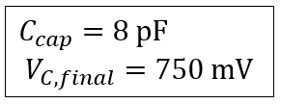
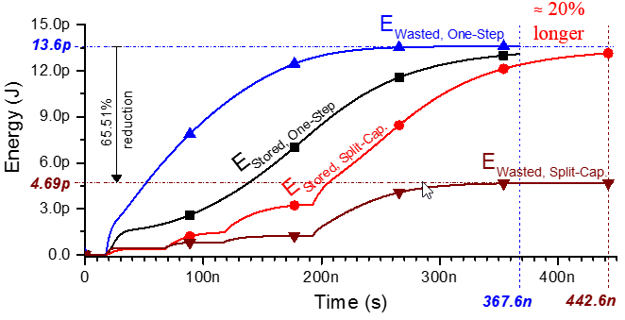
Schematic Simulation One-Step vs. Split-Cap. Charging
Compares Charging behavior of Split-Capacitor Charging (four-step)
With one-step charging
Split-Cap. Charging outperforms, by providing 73.73% efficiency
Reducing energy wastage by 65.51%
With only 20% overhead of charging period

Slide 14
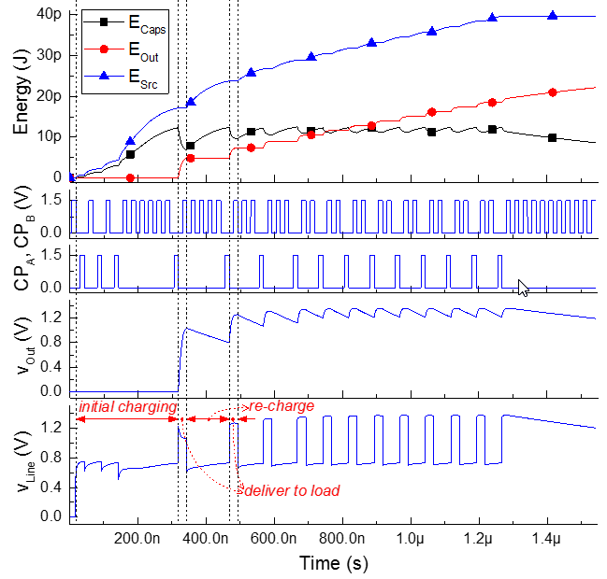
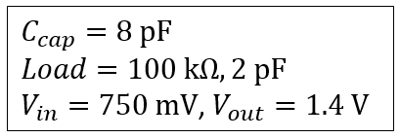
Split-Cap. Charging Based Boost Converter
Simulation results show
Improvement for short active periods
By incorporating Split-Cap. Charging
Comparison of Split-Cap. Vs. one-step charging
for various lengths of active periods
Boost Converter for an active period of ten clock cycles

Slide 15
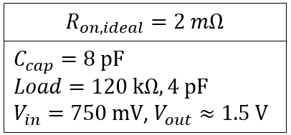
Viability of MEMS Switches in SC DC-DC Converter
To evaluate the viability, following five scenarios are used
All MOSFET switches
Input switch is ideal (MEMS), rest are MOSFETs
Output switch is ideal (MEMS), rest are MOSFETs
Both Input and output switches are ideal (MEMS), rest are MOSFETs
All switches are ideal (MEMS)
Non-overlapping signals are used to minimize switching losses
Act. Period (# cycles) | All are MOSFET SW | Only Input is Ideal SW | Only Output is Ideal SW | Both In/Output are Ideal SW | All are Ideal SW
20 | 69% | 71.96 | 69.55% | 72.97% | 72.12%
40 | 73.73% | 76.85% | 74.37% | 77.98% | 79.38%
250 | 80.35% | 83.46% | 81.12% | 84.77% | 89.34%
500 | 81.2% | 84.29% | 81.98% | 85.62% | 90.6%
1000 | 81.65% | 84.72% | 82.43% | 86.06% | 91.25%
*Using Split-Cap. Chrg. & Energy Recycling converter

Slide 16
Energy Recycling Voltage Scaler Based on Reconfigurable Capacitive Array
Syed Asmat Ali Shah, Saad Arslan, *HyungWon Kim
Dept. of Electronic Engineering, College of Electrical Engineering and Computer Science, Chungbuk National University
MSIS

Slide 17
Combining Split Charging and Energy Recycling
Overall Circuit Structure
Proposed Architecture
Capacitor Bank with Reconfigurable switches
Capacitor Bank

Slide 18
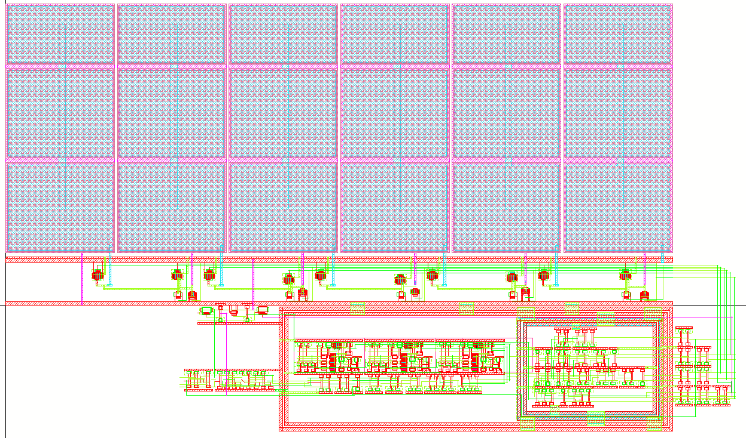
Combining Split Charging and Energy Recycling
Cadence Virtuoso Layout
Capacitor Bank (190 $μ$m x 70 $μ$m)
(Six Capacitors)
Switches
Digital Control Circuit
Comparator
Layout of the Proposed Architecture.

Slide 19
Efficiency Improvement by SCC and ER
For maximum power saving both the transitions should be optimized. i.e. SCC and ER
Relative gain of SCC and ER compared to conventional SC DC-DC converters

Slide 20
Proposed Architecture As a Buck Converter
For generating a target voltage ratio of 2/3 𝑉_{𝑖𝑛} , the capacitors are charged in two steps.
All of the capacitors are in series.
Two branches having three series capacitors.
Energy Recycling will be carried out in three steps.
First configuration three branches each having two series capacitors.
Second configuration two branches having three series capacitors.
Third configuration one branch having six series capacitors
Split Cap. Charging Configurations
Energy Recycling Configurations

Slide 21
Proposed Architecture As a Boost Converter
For generating a target voltage ratio of 2V_{in} , the capacitors are charged in four steps.
All of the capacitors are in series.
Two branches having three series capacitors.
Three branches having two series capacitors.
Six branches having one capacitor in each branch.
Energy Recycling will be carried out in three steps. (Same as Buck)
Split Cap. Charging Configurations
Energy Recycling Configurations

Slide 22
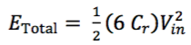
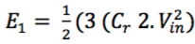
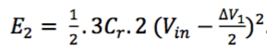
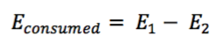
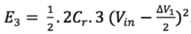
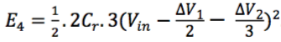
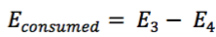
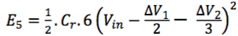
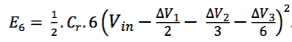
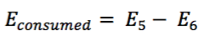
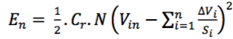
Energy Model for Energy Recycling Steps
Remaining Energy in Each Recycling Steps
Initial Energy After Charging:
Energy Recycling Step1:
Energy Recycling Step2:
Energy Recycling Step3:
General Form of Remaining Energy :

Slide 23
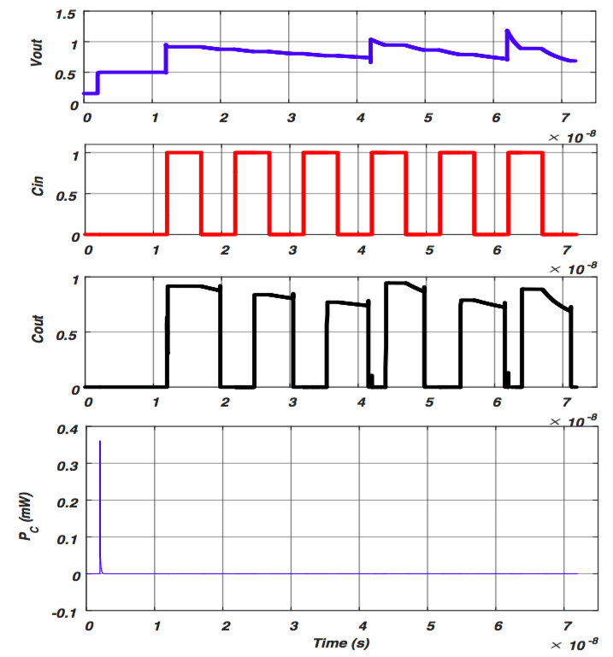
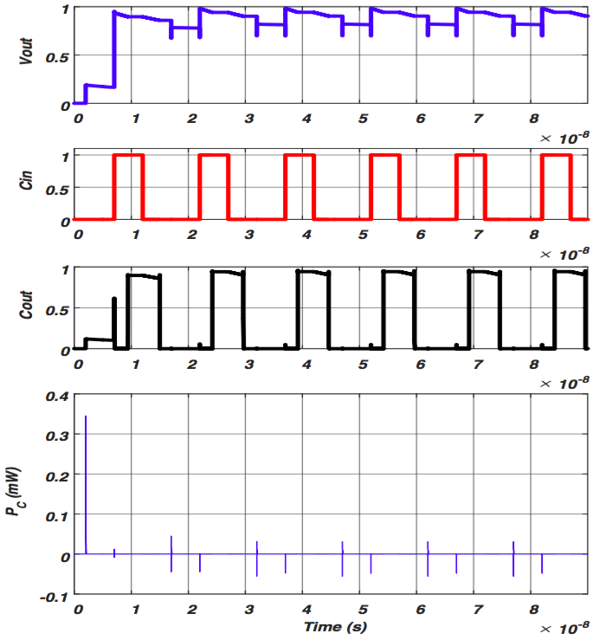
Simulation Results of Energy Recycling Steps
Simulation results with an active period of 6 addition operations followed by a long sleep period
Energy Recycling Voltage Converter
Conventional Voltage Converter

Slide 24
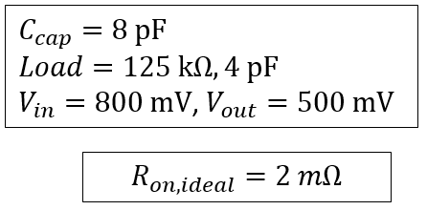
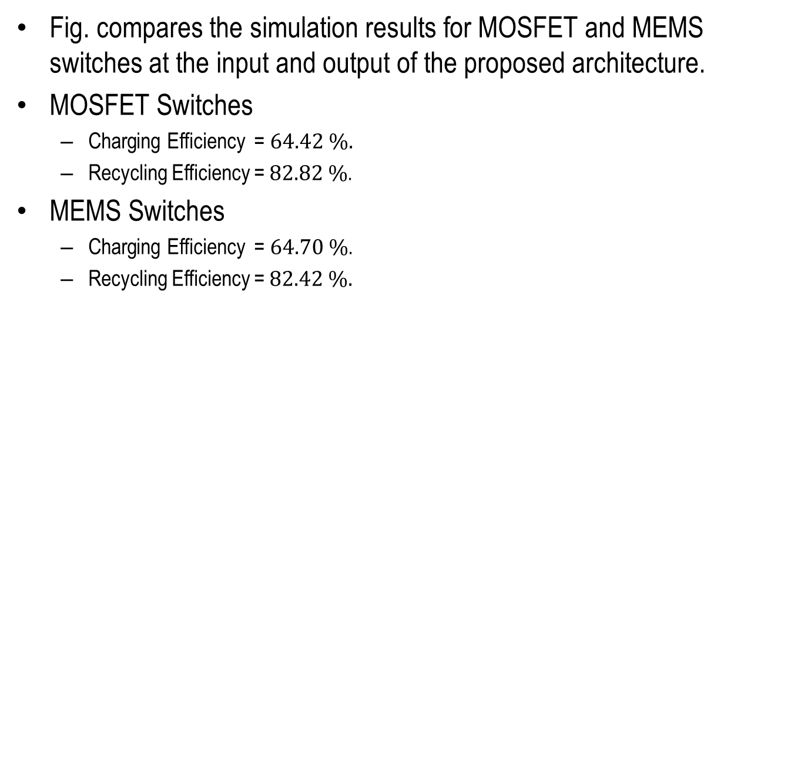
Viability of MEMS Switches in SC DC-DC Converter For short Active period Charge & Recycle (Light Load)
Fig. compares the simulation results for MOSFET and MEMS switches at the input and output of the proposed architecture.
MOSFET Switches
Charging Efficiency = $64.42 \%.$
Recycling Efficiency = $82.82 \%$.
MEMS Switches
Charging Efficiency = $64.70 \%$.
Recycling Efficiency = $82.42 \%.$
Simulation results with (a) real transistors (b) Ideal switches.

Slide 25
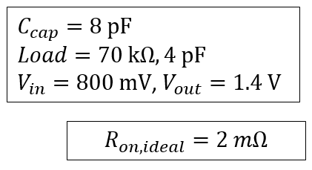
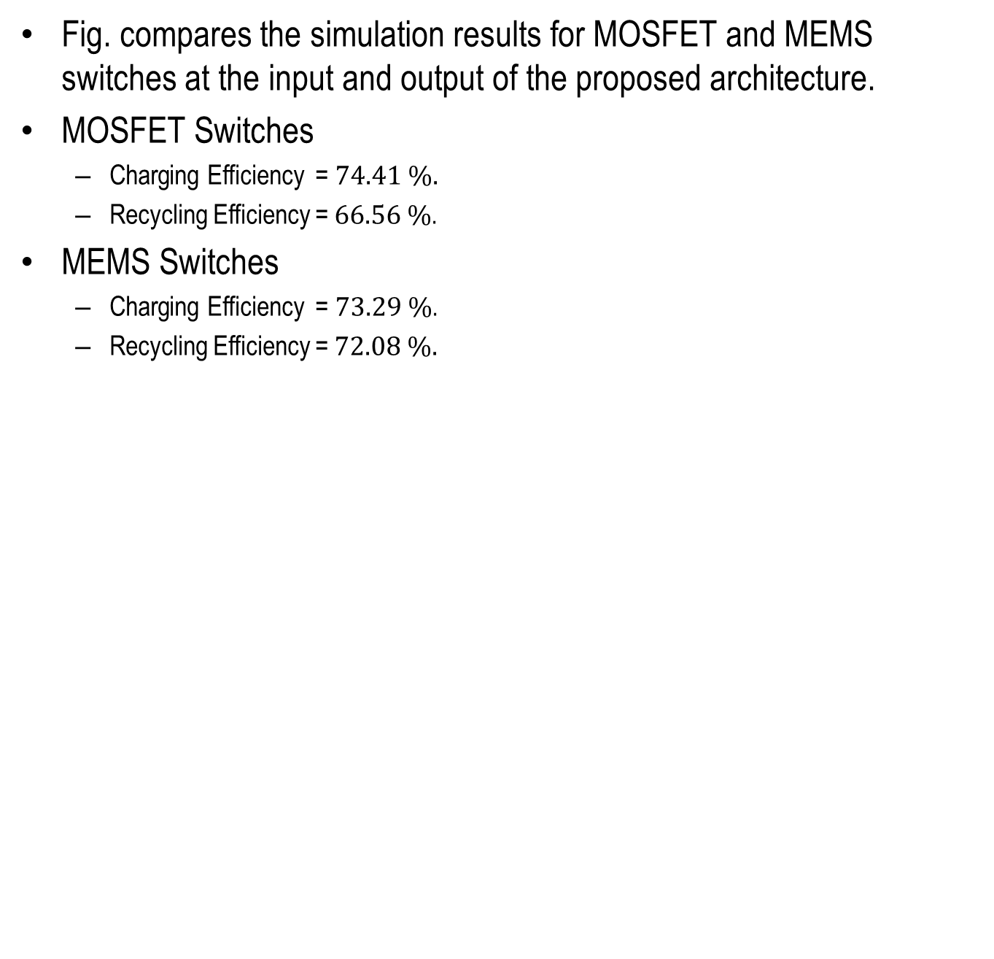
Viability of MEMS Switches in SC DC-DC Converter
For short Active period Charge & Recycle (Heavy Load)
Fig. compares the simulation results for MOSFET and MEMS switches at the input and output of the proposed architecture.
MOSFET Switches
Charging Efficiency = $74.41 \%.$
Recycling Efficiency = $66.56 \%$.
MEMS Switches
Charging Efficiency = $73.29 \%$.
Recycling Efficiency = $72.08 \%.$
Simulation results with (a) real transistors (b) Ideal switches.

Slide 26
Viability of MEMS Switches in SC DC-DC Converter -Conclusion
Initial Charging
For charging capacitor bank using ideal switches will not give any additional benefits.
Because during charging a capacitor resistance (R) doesn’t impact energy.
For Continuous phase
It shows improvement in energy efficiency
The charging is done quickly which reduces losses while delivery to load
Energy Recycling
For Energy recycling for higher current (Heavy Load), we can have some improvements in efficiency.
However, a much higher operating frequency of the MEMS switches is needed
To make them useable in low power circuits

Slide 27
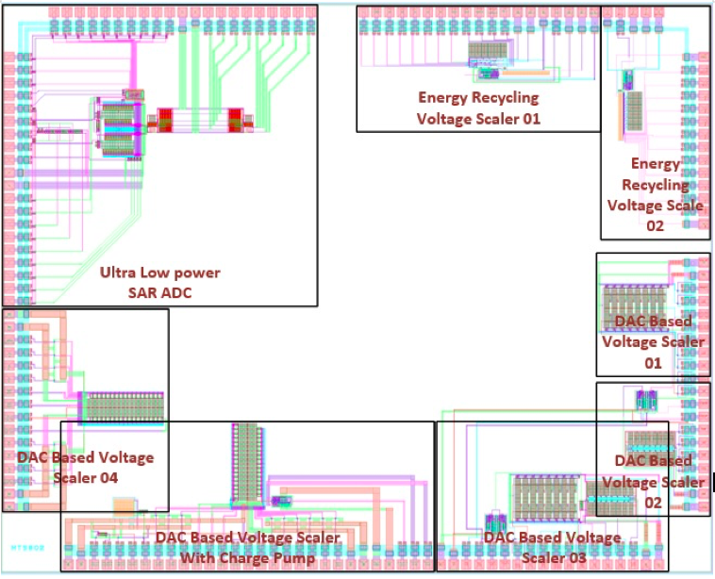
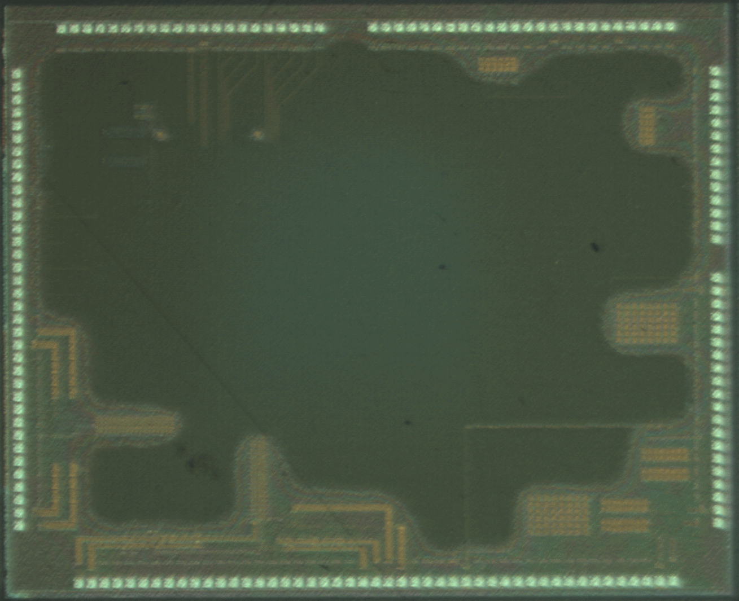
Voltage Scaler Test Chip MPW
MPW Process: Magnachip CMOS 0.13um 1.5V Vdd.
Chip Size 5x5mm
Voltage Scaler Test Chip
Voltage Scaler Test Chip

